Slide 1
WELCOME
TO
MIDDLE SCHOOL OPEN HOUSE
SCHOOL YEAR 2023-2024!
Freedom Park School

Slide 2

FREEDOM PARK SCHOOL ADMINISTRATORS
Principal - Dr. Titania Singh
Assistant Principal – Mrs. Amanda Darville
Assistant Principal - Mrs. Wendy May
Website: http://freedompark.rcboe.org
Address: 345 42nd Street Building 43400 Ft. Gordon, Ga 30905
Phone: 706-796-8428 | Breakfast- 6:50 a.m. Instruction Begins- 7:25 a.m. Dismissal- 2:15 p.m.

Slide 3






HOMEROOMS AND CORE CONTENT AREA TEACHERS
6th Grade:
Mrs. Carla Nobles- Math & Science
Mrs. J. Smith- English Language Arts & Social Studies
7th & 8th Grade:
Dr. Martinarose Polnitz- English Language Arts
Ms. Vanesia McMillan- Science
Mr. Adam Mullis- Social Studies
Mr. Jerome Lyles- Mathematics

Slide 4
MIDDLE SCHOOL COLLABORATIVE TEACHERS
•Principal - Dr. Titania Singh
Ms. Kendra Belser- Reading
Ms. Erica Conner- English Language Arts
Mrs. Charlene Middleton- Mathematics
Mrs. L. Johnson- English Language Arts
Mr. Hill- Science & Social Studies
CONNECTIONS TEACHERS
Ms. Angels Smith- Computers/ AVID
Ms. Constance Brigham- Computers/ AVID
Ms. Shoemacher- Spanish
Coach Todd- Health
Coach Lovett- PE

Slide 5
Teacher Contacts
MR. LYLES CAN BE REACHED VIA EMAIL: LYLESJE@BOE.RICHMOND.K12.GA.US
MS. MCMILLAN CAN BE REACHED VIA EMAIL: MCMILVA2@BOE.RICHMOND.K12.GA.US
MR. MULLIS CAN BE REACHED VIA EMAIL: MULLIAD@BOE.RICHMOND.K12.GA.US
MRS. NOBLES CAN BE REACHED VIA EMAIL: NOBLECA@BOE.RICHMOND.K12.GA.US
DR. POLNITZ CAN BE REACHED VIA EMAIL: POLNIMA@BOE.RICHMOND.K12.GA.US
MRS. J. SMITH CAN BE REACHED VIA EMAIL: SMITHJA@BOE.RICHMOND.K12.GA.US

Slide 6
FPS Attendance Policy
Students are expected to be in school all day unless they are ill. Georgia State law only recognizes absences due to illness, religious holidays, medical or legal appointments, and funerals in the family. Parents have the right to present reasons they believe are justifiable to the Principal for consideration of other absences.
All absences require a written note from parents/guardians stating the reason for the absence. Emailed notes will not be accepted. A note without a reason and date of absence is unexcused. The note must include the student's full name, reason for absence, date(s) of absence, and parent/guardian signature.
In order to comply with district regulations and state law, when a student has 10 unexcused absences in one month or ten unexcused absences in one year, Richmond County administrators will petition the Juvenile Court System to seek mandatory attendance by a student. An unexcused absence is defined as any unauthorized absence from school. Examples include, but are not limited to:
1. Hair appointments
2. Oversleeping
3. Shopping
4. Missing the bus
5. Concerts
6. Babysitting
7. Failure to obtain private transportation to school
8. Mechanical problem
9. Failure to obtain leave of Absence request for absences

Slide 7
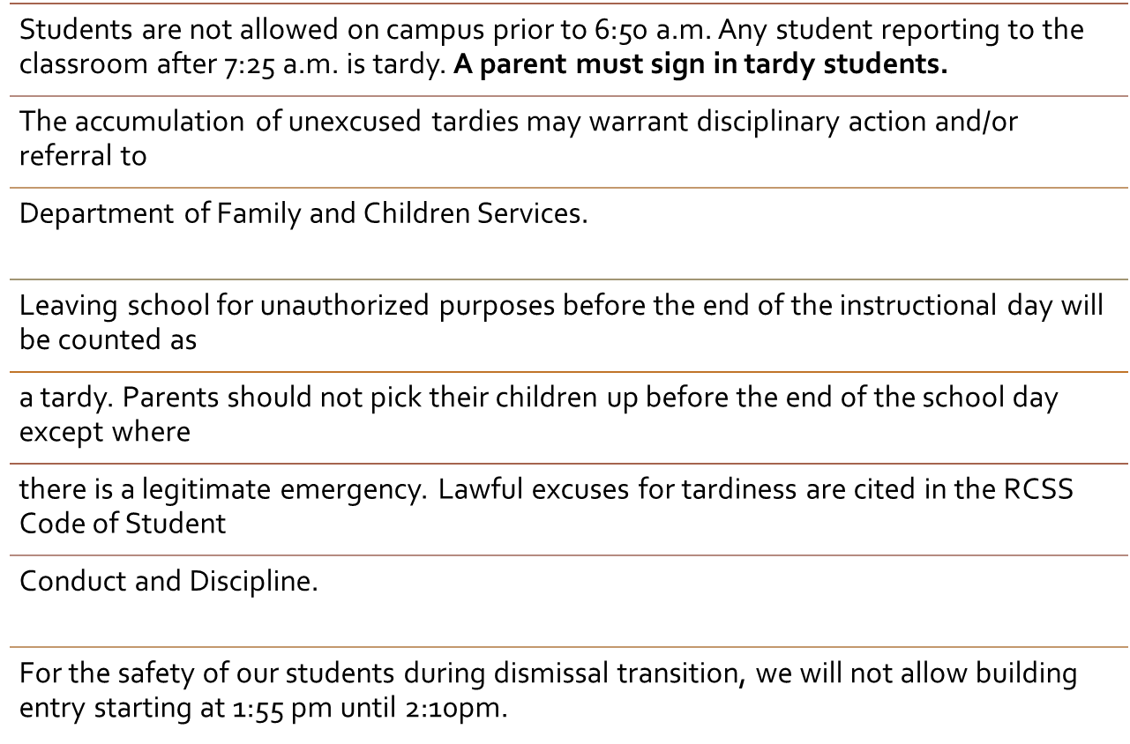
Tardy Policy

Slide 8

ELECTRONIC DEVICES
No headphones or bluetooth devices around the student's neck.
Students must ensure that cell phone capabilities of their devices are turned off during the day.
No wireless communication devices during the instructional day unless instructed to do so by the teacher.
Under the BYOD Policy, students may only possess, display, and use wireless communication devices before or after the instructional day.

Slide 9
Title I
Freedom Park School is a Title I school.
We are provided financial assistance through the Every Student Succeeds Act, Part A. Its overall purpose is to ensure that all students have a fair and equal opportunity to obtain a high-quality education and reach, at a minimum, proficiency on state assessments (i.e. GA Milestones, End-of-Course, etc.), as well as involve parents in their child's education.
There will be an upcoming Title I Annual Parent Meeting which will outline parent involvement opportunities - you will be sent meeting information via FPS's ClassDojo account later in the school year.
If you have any questions, please contact the FPS Title I Parent Facilitator:
Jovanghn Parks
parksjo@boe.richmond.k12.ga.us

Slide 10
CLASSROOM EXPECTATIONS
THE OVERARCHING EXPECTATION IN CLASS IS RESPECT: RESPECT FOR YOURSELF, RESPECT FOR OTHER STUDENTS, RESPECT FOR THE TEACHER/OR ANY INDIVIDUAL IN AUTHORITY, AND RESPECT FOR ANY GUESTS THAT MAY ENTER OUR REGULAR CLASSROOM OR VIRTUAL CLASS SESSIONS. ALTHOUGH THIS ENCOMPASSES ALL OTHER EXPECTATIONS, SEVERAL OTHERS ARE OUTLINED BELOW FOR CLARITY:
EVERYONE CAN & WILL LEARN!
DO YOUR BEST—EVERYDAY! YOUR EFFORT DETERMINES YOUR SUCCESS!
HAVE THE “I CAN DO IT” ATTITUDE! STICK TO IT. PUSH THROUGH.
CHOOSE TO LEARN & EXCEL!
BE PREPARED TO LEARN—EVERYDAY!

Slide 11
CLASSROOM DAILY PROCEDURES
Students must quietly enter the classroom, sit in their assigned seating arrangement, unpack necessary instructional materials, and follow directives according to the daily framework.

Slide 12




BREAKFAST & LUNCH
Breakfast starts and 6:50 am and IS free for all students. Breakfast ends at 7:20 am.
Middle School Lunch is between 12:00pm-12:45pm. It is NOT free for every student. Please apply for our free or reduced lunch plan.
*Please visit the lunchroom to apply.

Slide 13


Middle School Counselor
Mrs. Alridge
Office Phone: 706-796-8428 ext.3616
AlridPa@Richmond.k12.ga.us

Slide 14

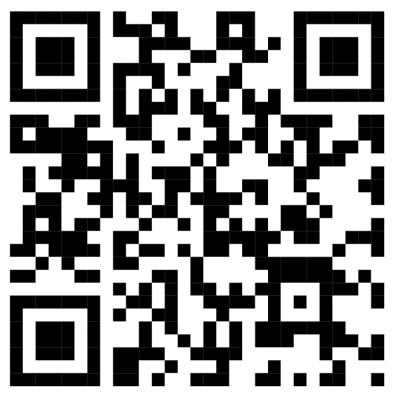
Middle School Counselor
ClassDojo
https://www.classdojo.com/ul/p/addKid?target=class&class=CG3VFXV

Slide 15
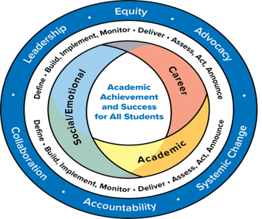
COUNSELING SERVICES INCLUDE:
Individual Counseling
Classroom Guidance (social/emotional, academic and career lessons )
Group counseling
Short-term individual counseling to students
Referrals for long-term support
Collaboration with families, teachers, community for student success

Slide 16
Bullying: No Bullying. It’s the Law
Bullying behavior is defined as any pattern of written or verbal expression or any physical act or gesture that is intended to ridicule, humiliate, intimidate, or cause measurable physical or emotional distress upon one or more students:
A student shall not do, attempt, or threaten to bully any person, including students and employees:
a) In the school
b) On school grounds
c) In school vehicles (including school buses)
d) At school bus stops
e) Or at school activities or sanctioned events
A third instance of bullying in a school year would require that the student be assigned to an alternative educational setting. However, the principal or other appropriate designee may recommend the Alternative Center or suspension, in her discretion prior to the third offense.
FPS adheres to the grades 6 -12 DISCIPLINE (RCBOE CODE OF CONDUCT); REFER TO RULES 23, 24, & 27.
Also refer to the Code of Discipline for Freedom Park School.
Students are expected to display admirable Character Traits at all times. They are representative of their family, school and community. At FPS we have always maintained a respectful environment for staff and students.

Slide 17
HOMEWORK
Homework is usually assigned DAILY. Please check your student’s calendar, To-Do list, iReady, and Class Dojo. Also check Infinite Campus for updated assignment information. Homework should be written by the student in the agenda as it is assigned.

Slide 18
Supplies
Composition notebook (portfolio)
Loose-leaf Paper
Pencil(s)
Color Pencils
Highlighters
Glue Sticks (Large)
Earbuds/Headphones with microphone
Pocket folder
Calculator

Slide 19
CLASS INSTRUCTION/DURATION:
~Period 1: 7:30-8:20AM
~Period 2: 8:20-9:10AM
~Period 3: 9:10-10:00AM
~Period 4: 10:05-10:55AM
~Period 5: 10:55-11:45AM
~Period 4: 11:45-1:55PM (Lunch Included)
~Period 6: 1:00-1:50PM
*The instructional session times are subject to change.

Slide 20

Science Fair Information
All students are expected to do a science fair project. Students will receive science fair information within the first few weeks of school and are expected to choose a topic. Science Fair Projects are intended to be in depth research and experimentation that includes data, results, and conclusions.

Slide 21


COURSE ASSESSMENT PLAN
EACH STUDENT WILL RECEIVE A VARIETY OF ASSIGNMENTS DESIGNED TO ENHANCE THEIR LEARNING.
GRADING SYSTEM
Formative Assessments: 40%
Bell Work
Journals
Notebook Activities
Class Participation
Homework
Summative Assessments: 60%
Tests
Quizzes
Projects
IMPORTANT!!!
Please check ClassDojo and Infinite Campus twice (2x's) per week to check the status of your child's grades and assignments.

Slide 22
Missed work
It is the student’s responsibility to obtain any missed assignments, notes, or other pertinent information necessary due to an absence or tardy. Students must provide a verifiable excuse (within 7 days) in order to receive full credit for any missed assignments after returning from an excused absence.

Slide 23
Late Assignments
It is the student’s responsibility to turn in all assignments ON TIME. Assignments turned in late (1 – 7 days) will be updated in infinite campus within two weeks.
Assignments satisfactory turned in after 7 days of the due date (without a medical excuse) will receive a grade of 70%. After 7 days, the academic purpose and value of the assignment has diminished.

Slide 24






PRIMARY RESOURCES

Slide 25






SECONDARY RESOURCES

Slide 26

TUTORING IS AVAILABLE!!
LOG ON FOR A "JUST IN TIME" SESSION OR SCHEDULE AN APPOINTMENT FOR A LATER TIME.
PLEASE LOOK FOR THIS ICON ON YOUR LAUNCHPAD.

Slide 27
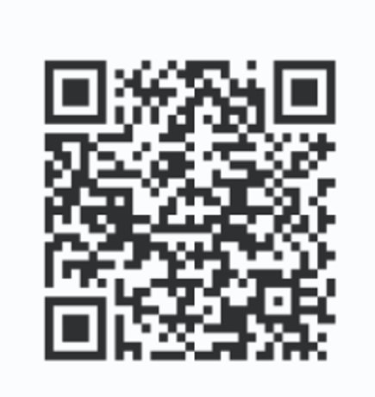
Thank you for viewing our Open House! Please take 2-3 minutes to complete the questionnaire below.

